Slide 1



Session 4
Working with ADO.NET and Entity Framework
For Aptech Centre Use Only

Slide 2
Session Overview
EDxOp.lNaiEnTA
Dowestcoricboenhnect to a database
oEwxptloaianchcess data with ADO.NET
eDEefnintietythFramework
For Aptech Centre Use Only

Slide 3
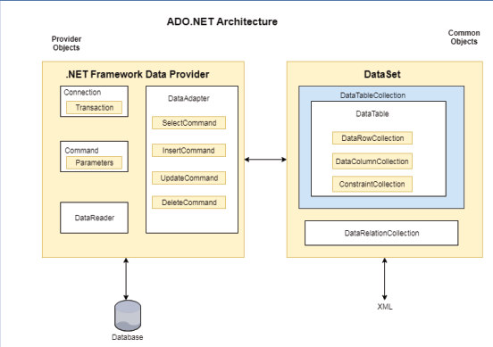
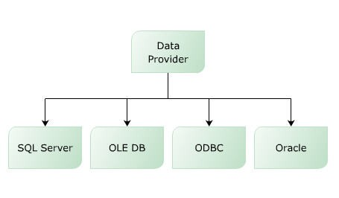
Overview of ADO.NET (1-3)
Core component of .NET Framework
Is used for establishing a connection between an application and data sources
For Aptech Centre Use Only
Data Providers
ADO.NET Architecture

Slide 4
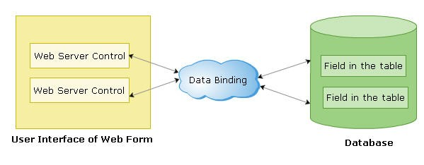
Overview of ADO.NET (2-3)
Advantages of ADO.NET are:
Single Object-oriented API
Managed Code
Extensible Markup Language (XML) Support Visual Data Components
Performance and Scalability
For Aptech Centre Use Only

Slide 5
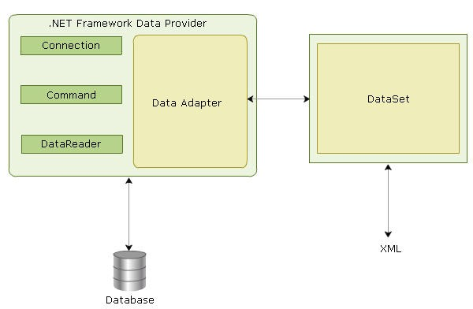
Overview of ADO.NET (3-3)
For Aptech Centre Use Only
SqlConnection object
SqlCommand object
SqlDataReader object
DataSet object
SqlDataAdapter object

Slide 6
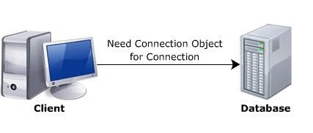
Connecting to a Database (1-6)
For Aptech Centre Use Only

Slide 7
Connecting to a Database (2-6)
Parameter Name
Description
Data Source
Local machine, machine domain name, or IP address that identifies the server
Initial Catalog
Name of the database
Integrated Security
Often set to SSPI to make a connection with the user’s Window login. This parameter is optional
For Aptech Centre Use Only
User ID
User’s ID configured in SQL Server
Password
Password matching SQL Server UserID
Connection String

Slide 8
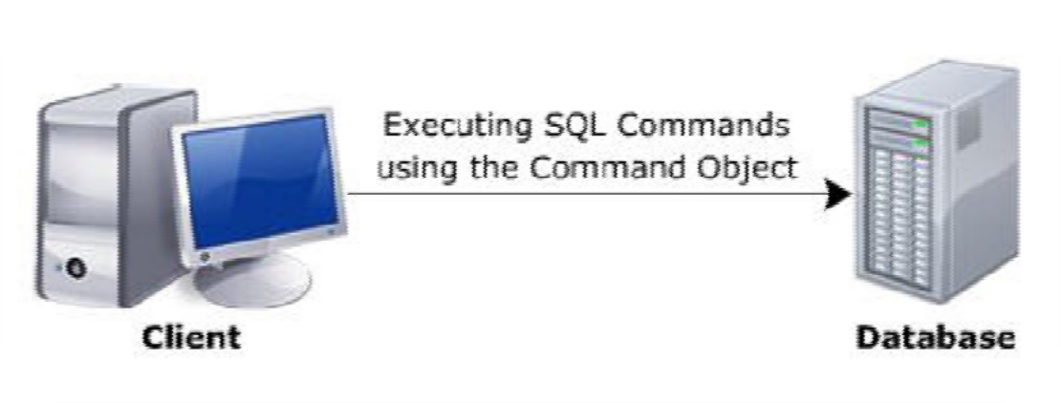
Connecting to a Database (3-6)
Transfer the connection to other ADO.NET
objects
Execute database operations with other ADO.NET
objects
Establish the SqlConnection
Open the connection
Close the connection
For Aptech Centre Use Only

Slide 9
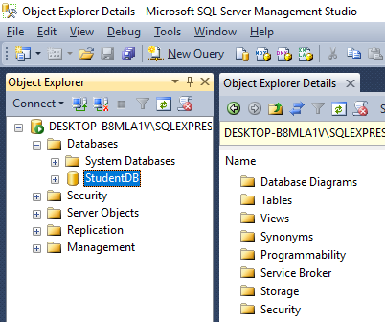
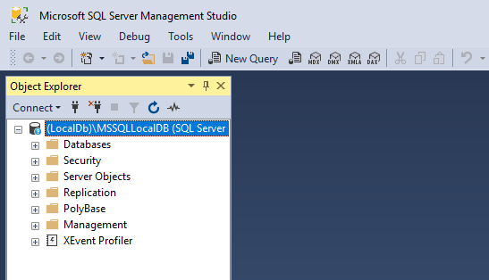
Connecting to a Database (4-6)
For Aptech Centre Use Only
StudentDB Database Created
SQL Server Management Tool

Slide 10
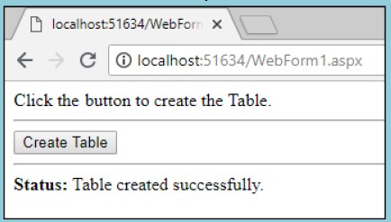
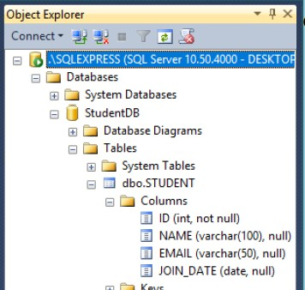
Connecting to a Database (5-6)
Create Table Web Page
For Aptech Centre Use Only
Table Structure in SSMS

Slide 11
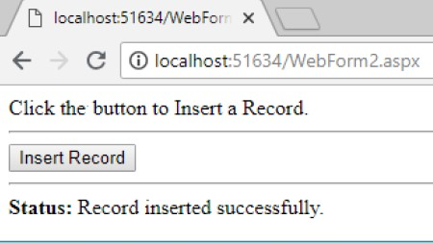
Connecting to a Database (6-6)
For Aptech Centre Use Only
Insert Record Web Page

Slide 12
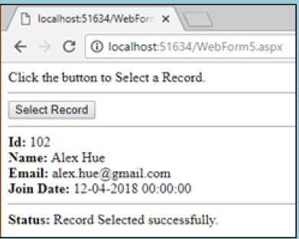
Accessing Data with ADO.NET (1-2)
Retrieving data inserted using C# code
For Aptech Centre Use Only
Select Record Web Page

Slide 13
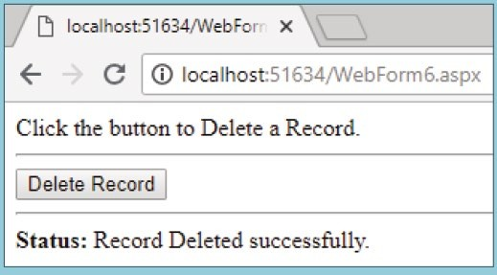
Accessing Data with ADO.NET (2-2)
Deleting a row using C# code
For Aptech Centre Use Only
Delete Record Web Page

Slide 14
Entity Framework (1-2)
Entity Framework (EF) is an Object Relational Mapping (ORM) tool that is used to connect to the database.
In the EF, the ADO.NET methods and classes used for performing data operations are not written by the developer.
Using EF, business objects and entities are generated according to the database tables.
For Aptech Centre Use Only
 | It provides the mechanism for:
Working with basic CRUD operations Supporting one to one, one to many, and many to many relationships Creating inheritance relationships between entities

Slide 15
Entity Framework (2-2)
It provides following benefits:
Uses higher level languages to write data access logic
Uses relationships among entities to represent conceptual model in a better way
Replaces all underlying data store without much overhead as data access logic is at a higher level
Connection to the database is through the following three approaches:
For Aptech Centre Use Only
Database First
Model First
Code First

Slide 16
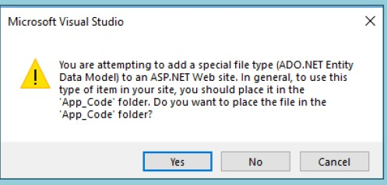
Usage in ASP.NET (1-6)
For Aptech Centre Use Only
Microsoft Visual Studio Dialog Box

Slide 17
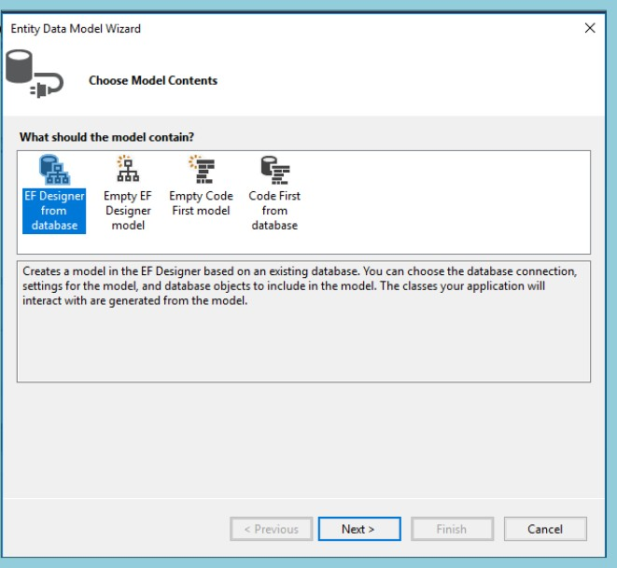
Usage in ASP.NET (2-6)
For Aptech Centre Use Only
Entity Data Model Wizard

Slide 18
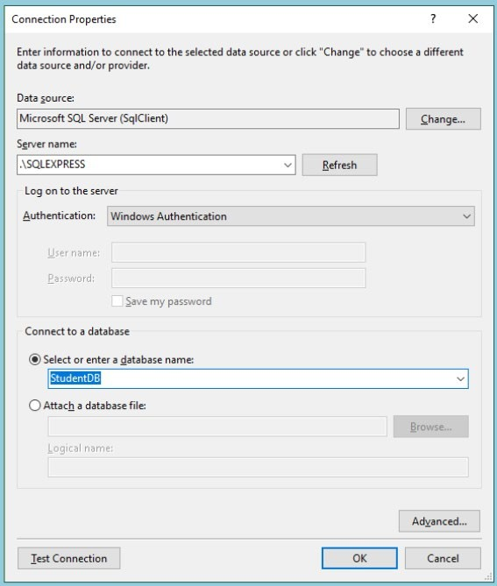
Usage in ASP.NET (3-6)
For Aptech Centre Use Only
Connection Properties

Slide 19
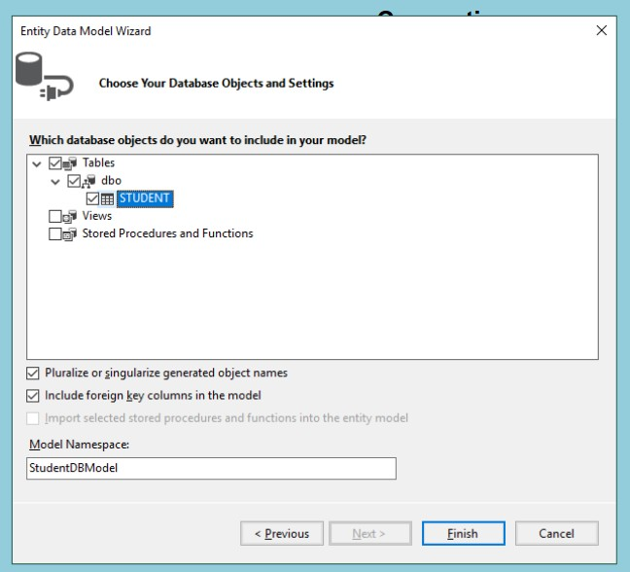
Usage in ASP.NET (4-6)
For Aptech Centre Use Only
Entity Data Model Wizard

Slide 20
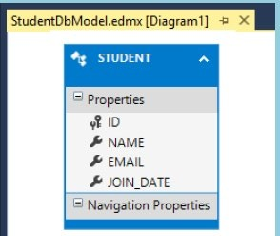
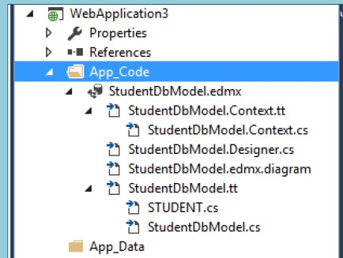
Usage in ASP.NET (5-6)
For Aptech Centre Use Only
Database Diagram
Models in Solutions Explorer

Slide 21
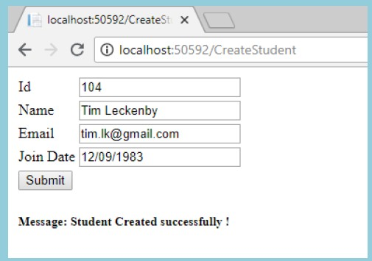
Usage in ASP.NET (6-6)
For Aptech Centre Use Only
Output for CreateStudent Form

Slide 22
Entity Framework Core
EF Core is the new version released by Entity Framework post EF 6.x.
Some of its characteristics include:
Open-source, Lightweight , Extensible, and Cross-platform
EF Core can be used with:
.NET Core applications
Framework-based applications (.NET Framework 4.5+)
Code-First and Database-First are supported by EF Core.
For Aptech Centre Use Only

Slide 23
Summary
ADO.NET is a core component of .NET Framework and is used for establishing a connection between an application and its data sources.
Various ADO.NET objects for an SQL data source are namely, SqlConnection object, SqlCommand object, SqlDataReader object, DataSet object, and SqlDataAdapter object.
Command objects use the connection object to know which database to execute the command on.
SQL statements are sent to the database through a command object.
Entity Framework is an Object Relational Mapper (ORM). Business objects and entities are generated through this Framework according to the database tables.
For Aptech Centre Use Only

